Slide 1
Number Plate Recognition
Project Plan Presentation:

Slide 2
Outline of project plan:
First sprint (29/10/2020):
Design
Second sprint (19/11/2020): Get the basic java application created
Third sprint (10/12/2020): Threading
Fourth Sprint (7/1/2020): Working with docker
Notes:
So the first thing I wanted to cover is a timeline we created of goals for each sprint on our part of the system. Today is the end of sprint one which is the design phase and that is what this presentation will talk about. I will go into detail about how our part fits into the whole project, then outline function, non functional, deployment and testing requirements before showing use case diagrams that explain these requirements and I will end with an explanation of how data flows within our system.
Sprint two which we want completed by 19th november will involve us making a working skeleton of our system, in short, we want to create a java application that can recognise number plates from images recieved from a JMS queue and add the number plate to a message that is then sent within a topic.
Sprint three ending on the 12th december is aimed at making our application more efficient by adding the use of threading. This will require additional research as it is something that none of our group have worked with before and that is why we have dedicated the entire sprint to it.
The final stage of the plan is to get our application working not only with threads but also with docker. This essentially means we will be able to scale our application dependant on the queue size of image ID’s. Multiple self contained operating systems will be able to be spun up to run our application and recognise number plates more efficiently.

Slide 3
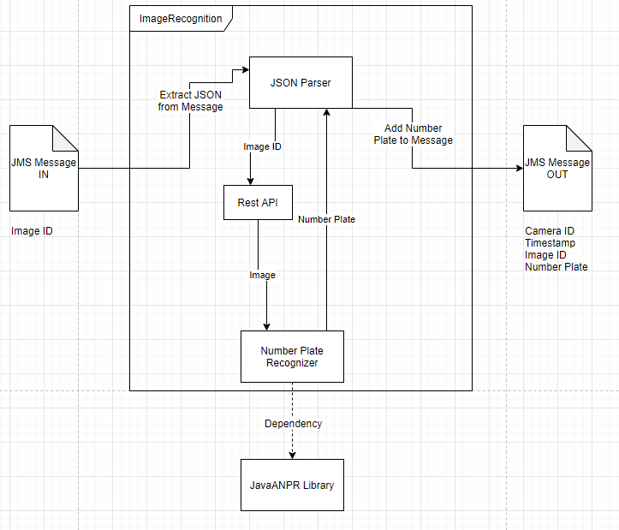
How we fit into the overall system:
Notes:
This initial diagram shows exactly how we our application will fit into the overall system. We follow on from group one whose job it is to store images from the cameras which are receivable by our group.
Our application will begin by receiving the messages from the queue created by group 1. The message will contain an image ID. Our job is to then deserialise this message into JSON and parse the data. With the Image ID we can put that into the REST API created by group 1 to get back the actual image. With the image we put that into number plate recogniser we create using the ANPR library and that returns us the number plate in the image. The camera ID, timestamp, image id and number plate is then serialised into a message after getting the other pieces of data from a seperate REST API call and placed in a topic that can be accessed by the other groups that need that information.

Slide 4
Functional Requirements:
Receive messages from P1(Receiving Image Team) queue.
Talk to P1 API to get image of number plate
Deconstruct the serialised object
Recognise the number plate and add this to the object.
Serialise the object with the number plate attached
Send objects as a topic.
Scale on high traffic.
Notes:
Our part of the system has a number of functional requirements that I will now explain.

Slide 5
Non Functional requirements:
Tear down on low traffic from P1(Receiving Image Team) based on what is in the queue. (Docker/VMs)

Slide 6
Testing requirements:
Tests to carry out:
Selection of images to test with
Working ActiveMQ server to test on
Access to Java ANPR library
Test scaling up on queue length
Test tearing down on queue length
Test JMS messages in and out
Test getting the image from the API using the Image ID
Test image recognition

Slide 7
Deployment requirements
Site to deploy the code to for use in the overall solution
Access to the JavaANPR library
ActiveMQ server for the whole project with all the queues and topics from the system on.
Need a properties file that can be injected to talk to the ActiveMQ server

Slide 8
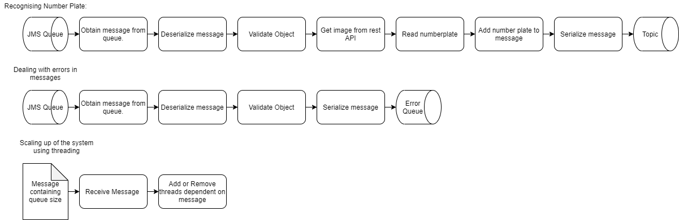
Use Case Diagrams
Notes:
To breakdown our system diagram into parts that are easier to explain we created a set of use case diagrams to show exactly how our functional requirements will be met.

Slide 9
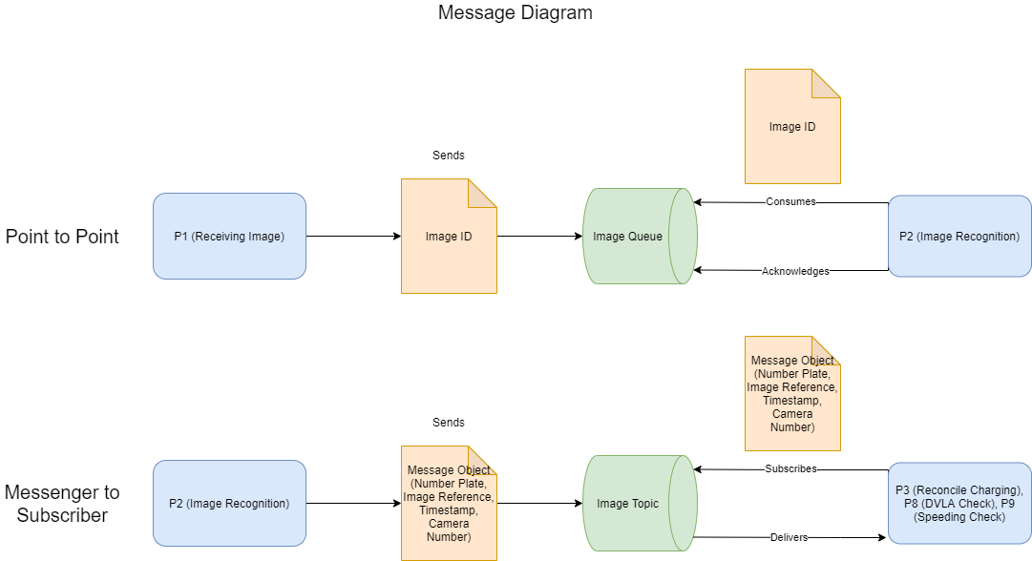
Message Model:
Notes:
The final diagram I will be showing is how the messaging system should work within our part of the system.

